Slide 1
Map 1 and Map 2

Slide 2
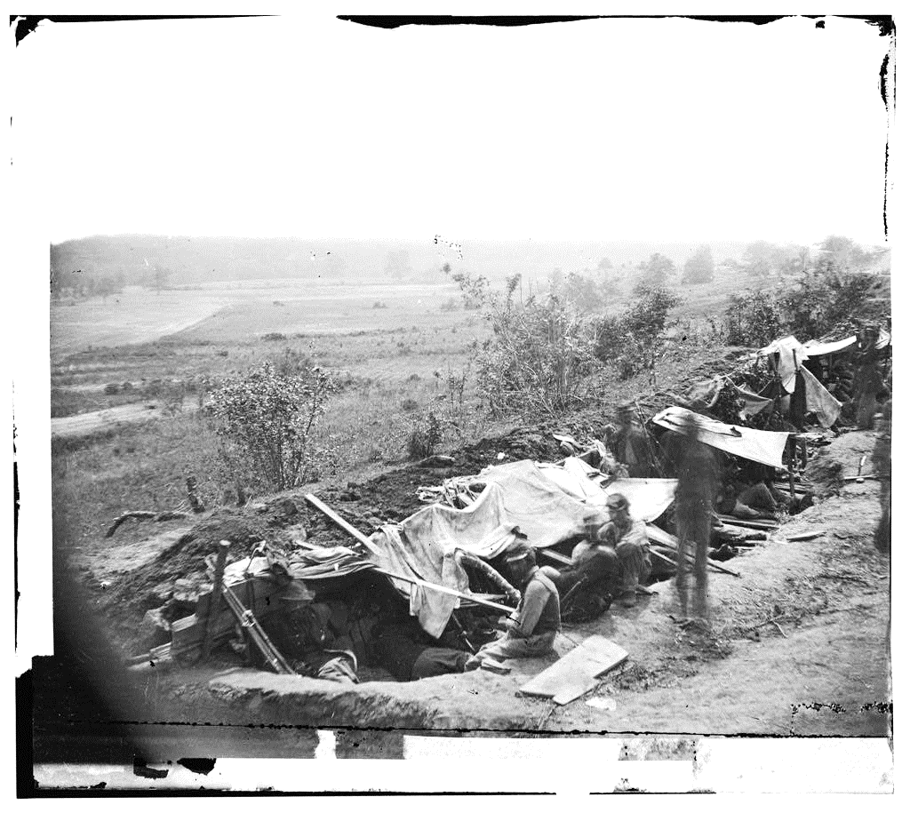
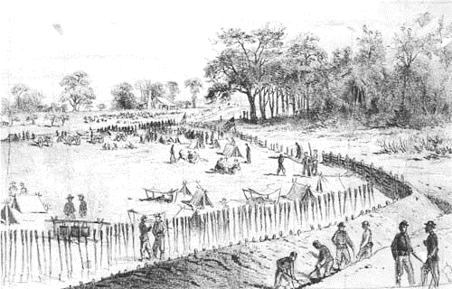
Image 1 and Image 2

Slide 3
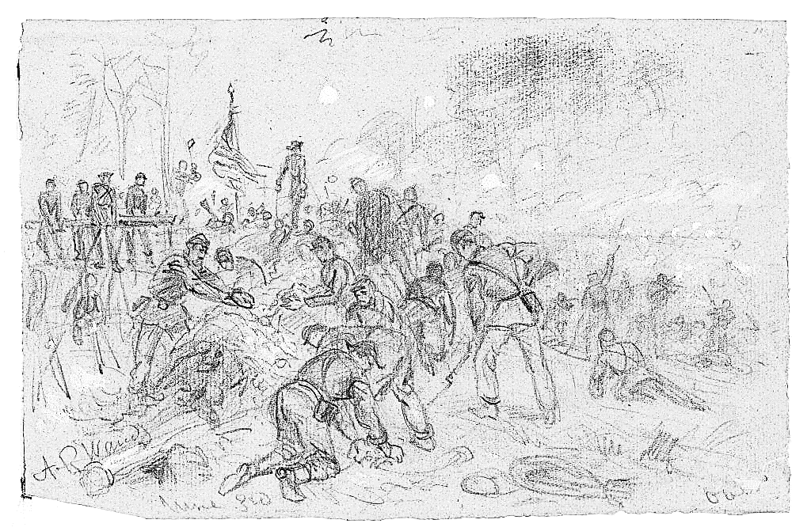
Image 3 and Image 4

Slide 4
Image 5

